Slide 1

Chapter 38 Advanced Java Database Programming

Slide 2
Objectives
To create a universal SQL client for accessing local or remote database (§38.2).
To execute SQL statements in a batch mode (§38.3).
To process updateable and scrollable result sets (§38.4).
To simplify Java database programming using RowSet (§38.5).
To create a custom table model for RowSet (§38.5).
To store and retrieve images in JDBC (§38.7).

Slide 3
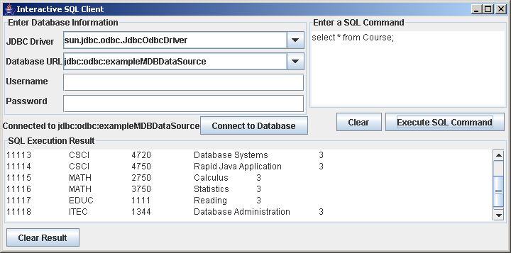
Example:
Creating an Interactive SQL Client
Connect to any JDBC data source.
Entering and executing SQL commands interactively
The execution result is displayed for the SELECT queries, and the execution status is displayed for the non-SELECT commands.
SQLClient
Run

Slide 4
Batch Updates
To improve performance, JDBC 2 introduced the batch update for processing nonselect SQL commands. A batch update consists of a sequence of nonselect SQL commands. These commands are collected in a batch and submitted to the database all together.
  Statement statement = conn.createStatement();
  // Add SQL commands to the batch
  statement.addBatch("create table T (C1 integer, C2 varchar(15))");
  statement.addBatch("insert into T values (100, 'Smith')");
  statement.addBatch("insert into T values (200, 'Jones')");
  // Execute the batch
  int count[] = statement.executeBatch();
The executeBatch() method returns an array of counts, each of which counts the number of the rows affected by the SQL command. The first count returns 0 because it is a DDL command. The rest of the commands return 1 because only one row is affected.

Slide 5
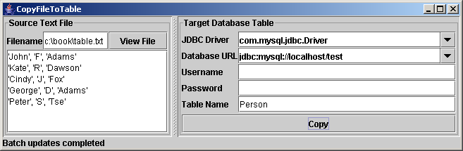
Example: Copying Text Files to Table
Write a program that gets data from a text file and copies the data to a table. The text file consists of the lines, each of which corresponds to a row in the table. The fields in a row are separated by commas. The string values in a row are enclosed in single quotes. You can view the text file by clicking the View File button and copy the text to the table by clicking the Copy button. The table must already be defined in the database.
CopyFileToTable
Run

Slide 6
Scrollable and Updateable Result Set
The result sets used in the preceding examples are read sequentially. A result set maintains a cursor pointing to its current row of data. Initially the cursor is positioned before the first row. The next() method moves the cursor forward to the next row. This is known as sequential forward reading. It is the only way of processing the rows in a result set that is supported by JDBC 1.
With JDBC 2, you can scroll the rows both forward and backward and move the cursor to a desired location using the first, last, next, previous, absolute, or relative method. Additionally, you can insert, delete, or update a row in the result set and have the changes automatically reflected in the database.

Slide 7
Creating Scrollable Statements
To obtain a scrollable or updateable result set, you must first create a statement with an appropriate type and concurrency mode. For a static statement, use
  Statement statement = connection.createStatement
  (int resultSetType, int resultSetConcurrency);
For a prepared statement, use
  PreparedStatement statement = connection.prepareStatement
  (String sql, int resultSetType, int resultSetConcurrency);
The resulting set is scrollable
  ResultSet resultSet = statement.executeQuery(query);
TYPE_FORWARD_ONLY
TYPE_SCROLL_INSENSITIVE
TYPE_SCROLL_SENSITIVE
CONCUR_READ_ONLY
CONCUR_UPDATABLE

Slide 8
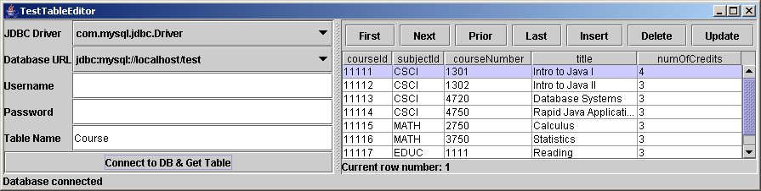
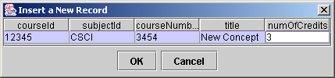
Example: Scrolling and Updating Table
Develop a useful utility that displays all the rows of a database table in a JTable and uses a scrollable and updateable result set to navigate the table and modify its contents. defined in the database.
Insert a new row
TestTableEditor
TableEditor
NewRecordDialog
Run

Slide 9
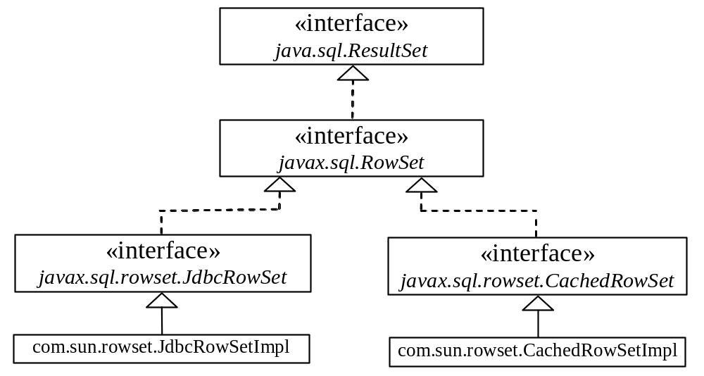
RowSet: JdbcRowSet and CachedRowSet
JDBC 2 introduced a new RowSet interface that can be used to simplify database programming. The RowSet interface extends java.sql.ResultSet with additional capabilities that allow a RowSet instance to be configured to connect to a JDBC url, username, password, set a SQL command, execute the command, and retrieve the execution result.

Slide 10
SQL BLOB and CLOB Types
Database can store not only numbers and strings, but also images. SQL3 introduced a new data type BLOB (Binary Large OBject) for storing binary data, which can be used to store images.
Another new SQL3 type is CLOB (Character Large OBject) for storing a large text in the character format. JDBC 2 introduced the interfaces java.sql.Blob and java.sql.Clob to support mapping for these new SQL types. JBDC 2 also added new methods, such as getBlob, setBinaryStream, getClob, setBlob, and setClob, in the interfaces ResultSet and PreparedStatement to access SQL BLOB, and CLOB values.
To store an image into a cell in a table, the corresponding column for the cell must be of the BLOB type. For example, the following SQL statement creates a table whose type for the flag column is BLOB.
  create table Country(name varchar(30), flag blob,
  description varchar(255));
BLOB
CLOB

Slide 11
Storing and Retrieving Images in JDBC
To insert a record with images to a table, define a prepared statement like this one:
  PreparedStatement pstmt = connection.prepareStatement(
  "insert into Country values(?, ?, ?)");
Images are usually stored in files. You may first get an instance of InputStream for an image file and then use the setBinaryStream method to associate the input stream with a cell in the table, as follows:
  // Store image to the table cell
  File file = new File(imageFilenames[i]);
  InputStream inputImage = new FileInputStream(file);
  pstmt.setBinaryStream(2, inputImage, (int)(file.length()));
To retrieve an image from a table, use the getBlob method, as shown below:
  // Store image to the table cell
  Blob blob = rs.getBlob(1);
  ImageIcon imageIcon = new ImageIcon(
  blob.getBytes(1, (int)blob.length()));
Store image
Retrieve image

Slide 12
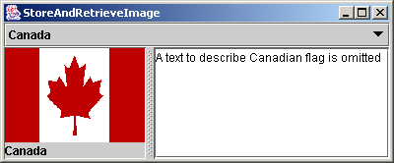
Example: Scrolling and Updating Table
In this example, you will create a table, populate it with data, including images, and retrieve and display images. The table is named Country. Each record in the table consists of three fields: name, flag, and description. Flag is an image field. The program first creates the table and stores data to it. Then the program retrieves the country names from the table and adds them to a combo box. When the user selects a name from the combo box, the country’s flag and description are displayed.
StoreAndRetrieveImage
Run

